Slide 1
Bay Area AirBnB Data: Investigation and Modeling Results
Drew Zinder DrewZinder@gmail.com August 3, 2022

Slide 2
Objective Given a sample of the AirBnB dataset in the San Francisco Bay Area for 2021, help determine factors driving booking rates and total revenue.
General Methodology
Data is investigated, cleaned, and has factors which could introduce modeling bias removed
Categorical values are encoded via dummy variables
Separate models are built to predict both booking rates and annual revenue
Feature importance (total_gain) illustrated by both XGBoost feature importances, as well as SHAP models, for additional insight

Slide 3
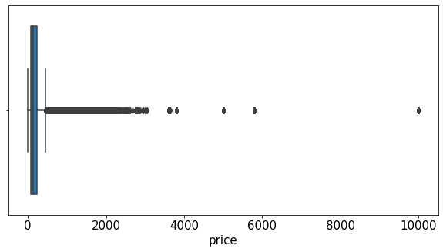
Data Investigation
Significant skew in pricing data

Slide 4
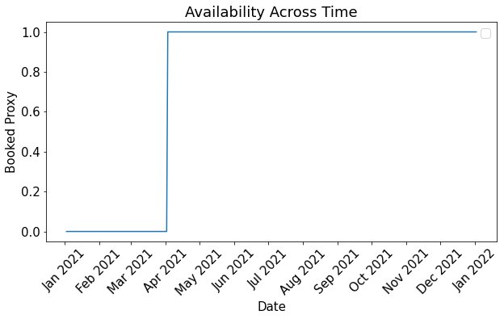
Data Investigation
Significant skew in pricing data
Additionally, availability variable is an incomplete indicator of whether or not a property has been booked by a customer

Slide 5
Data Investigation
Significant skew in pricing data
Additionally, availability variable is an incomplete indicator of whether or not a property has been booked by a customer
Significant cluster of properties where maximum nights variable is 1125. This value doesn’t divide cleanly into weeks / months / years—there may be some element of AirBnB policy leading to this.

Slide 6
Data Investigation
Significant skew in pricing data
Additionally, availability variable is an incomplete indicator of whether or not a property has been booked by a customer
Significant cluster of properties where maximum nights variable is 1125. This value doesn’t divide cleanly into weeks / months / years—there may be some element of AirBnB policy leading to this.
Small number of properties that required a 365-day minimum stay.

Slide 7
Data Investigation
Significant skew in pricing data
Additionally, availability variable is an incomplete indicator of whether or not a property has been booked by a customer
Significant cluster of properties where maximum nights variable is 1125. This value doesn’t divide cleanly into weeks / months / years—there may be some element of AirBnB policy leading to this.
Small number of properties that required a 365-day minimum stay.
Listings priced above the 99th percentile ($1,068 a night) and requiring a full year minimum stay were removed from modeling dataset.

Slide 8
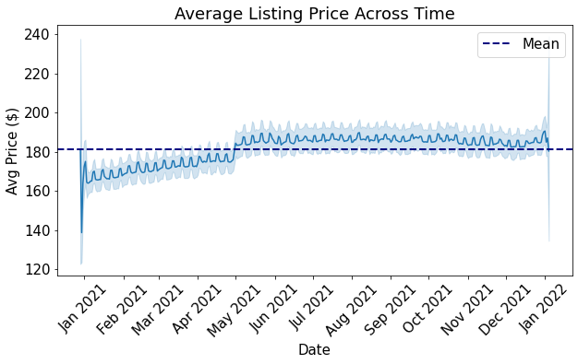
Average Price
High variation in price in January of both years. Likely due to holiday or seasonal effects.

Slide 9
Average Price
Price trends generally upward from January to April, with a significant uptick at the beginning of May, likely also due to seasonal effects. Price starts to trend back downwards in the fall.

Slide 10
Average Price
Price also indicates presence of weekly trends, with minor (but consistent) price increases for weekend dates.

Slide 11
Average Price
Pricing data ultimately appears to be stationary, allowing for modeling on average (rather than daily) values. This allows for the application of more powerful ML techniques that are not appropriate for longitudinal data.

Slide 12
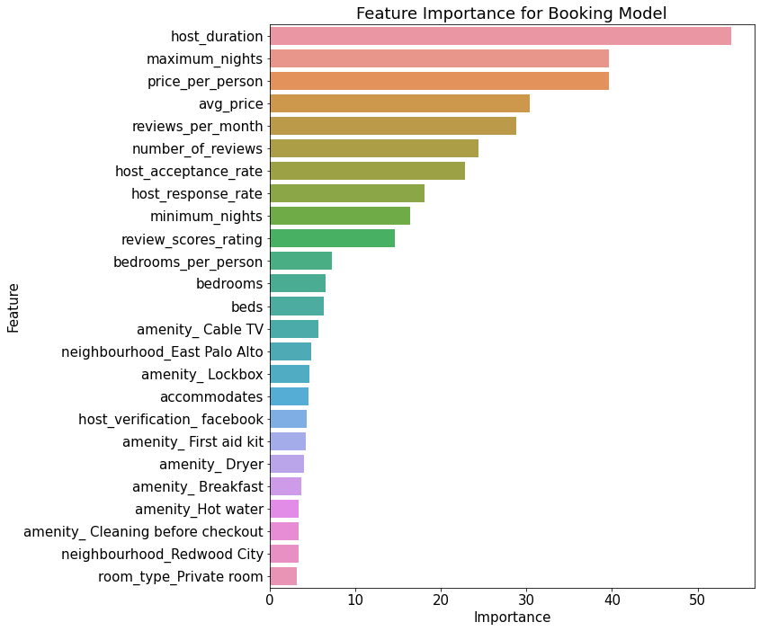
Model Results: Booking
Host Duration was the greatest indicator of booking probability

Slide 13
Model Results: Booking
Host Duration was the greatest indicator of booking probability
This is not-unexpected, as someone who's been a host with AirBnB for an extended period has likely determined how to best ensure their property is frequently booked
Alternatively, however, this could also be due to experienced hosts making their listing unavailable during slower seasons, for personal use or renovation

Slide 14
Model Results: Booking
Host Duration was the greatest indicator of booking probability
This is not-unexpected, as someone who's been a host with AirBnB for an extended period has likely determined how to best ensure their property is frequently booked
Alternatively, however, this could also be due to experienced hosts making their listing unavailable during slower seasons, for personal use or renovation
Maximum stay, price per person, and the price of the listing were all also strongly indicative of booking likelihood
Host review and responsiveness elements played a strong role as well, although number of reviews was more important than the value of those reviews

Slide 15
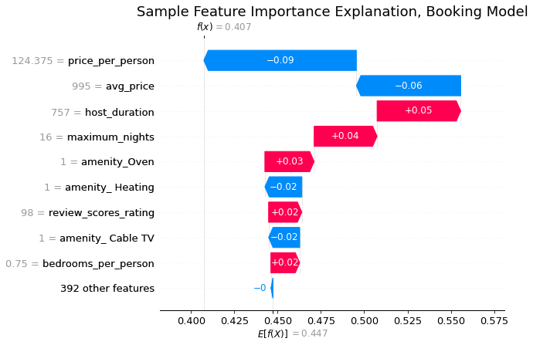
Model Results: Booking
Taking an example record for a deeper investigation of variable importance
Expected booking probability: 44.7%
This listing’s booking probability: 40.7%
Price per person, and the price of the listing itself, both contributed to reduced booking probability
Host duration & maximum nights both contributed positively

Slide 16
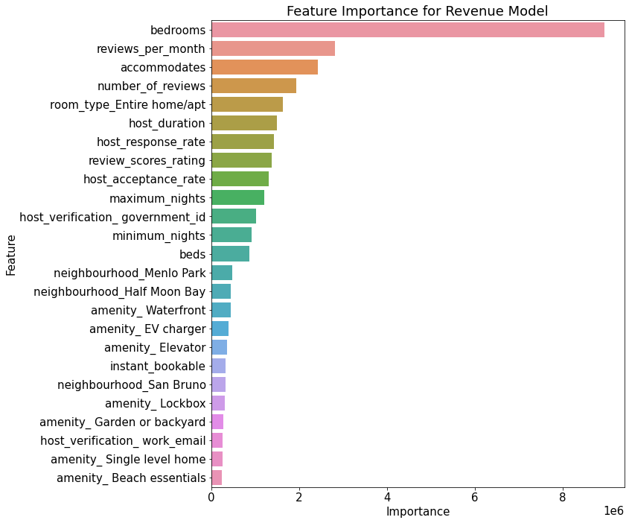
Model Results: Revenue
Number of bedrooms was, by far, the most impactful feature in the revenue model

Slide 17
Model Results: Revenue
Number of bedrooms was, by far, the most impactful feature in the revenue model
Accommodation type and the total accommodation per listing were both impactful as well, with a preference for the entire house / apartment being rented out

Slide 18
Model Results: Revenue
Number of bedrooms was, by far, the most impactful feature in the revenue model
Accommodation type and the total accommodation per listing were both impactful as well, with a preference for the entire house / apartment being rented out
Number and value of reviews were both fairly important, along with host response variables as well

Slide 19
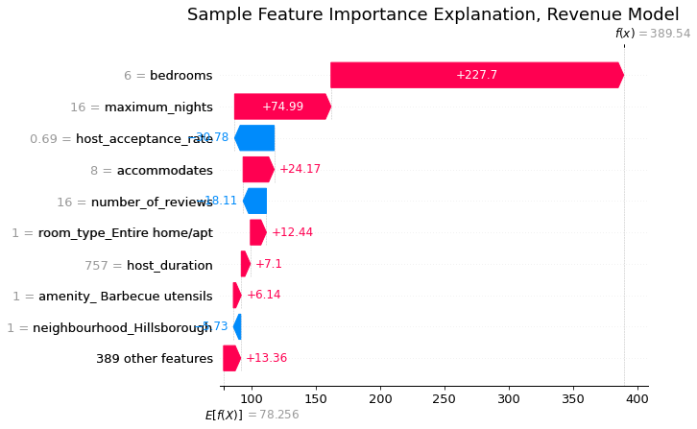
Model Results: Revenue
Taking an example record for a deeper investigation of variable importance
Expected average revenue: $78.26
This listing’s average revenue: $389.54
The number of bedrooms (6) contributed very strongly to the average revenue of this listing
Maximum nights also contributed positively
Other features largely balanced

Slide 20
Next Steps
Additional model segmentation could lead to feature-specific insights, at the cost of generality
Creating specific sub-models for the following categories could help illustrate unique opportunities:
Listings with a per-night price of $1,000 or greater
Specific neighbourhoods
Hosts with a large number of AirBnB properties

Slide 21
Next Steps
Additional model segmentation could lead to feature-specific insights, at the cost of generality
Creating specific sub-models for the following categories could help illustrate unique opportunities:
Listings with a per-night price of $1,000 or greater
Specific neighbourhoods
Hosts with a large number of AirBnB properties
Creating cluster variables for specific amenities (eg, categorizing several types of HDTV together, or multiple categories of luxury toiletries) may reveal additional insights

Slide 22
Next Steps
Additional model segmentation could lead to feature-specific insights, at the cost of generality
Creating specific sub-models for the following categories could help illustrate unique opportunities:
Listings with a per-night price of $1,000 or greater
Specific neighborhoods
Hosts with a large number of AirBnB properties
Creating cluster variables for specific amenities (eg, categorizing several types of HDTV together, or multiple categories of luxury toiletries) may reveal additional insights
Accurate data on when a listing has been booked by a customer or actual revenue values would greatly improve model accuracy, and would allow for the inclusion of additional explanatory variables

